Slide 1
IDIOM a group of words in a fixed order that have a particular meaning that is different from the meanings of each word on its own

Slide 2
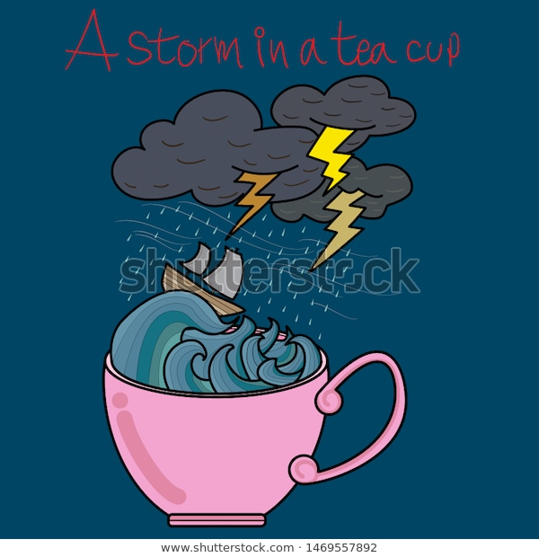
- a lot of unnecessary anger and worry about a matter that is not important

Slide 3
- to succeed in achieving two things in a single action

Slide 4
- to be unaware of what is going on from fantasies or daydreams

Slide 5
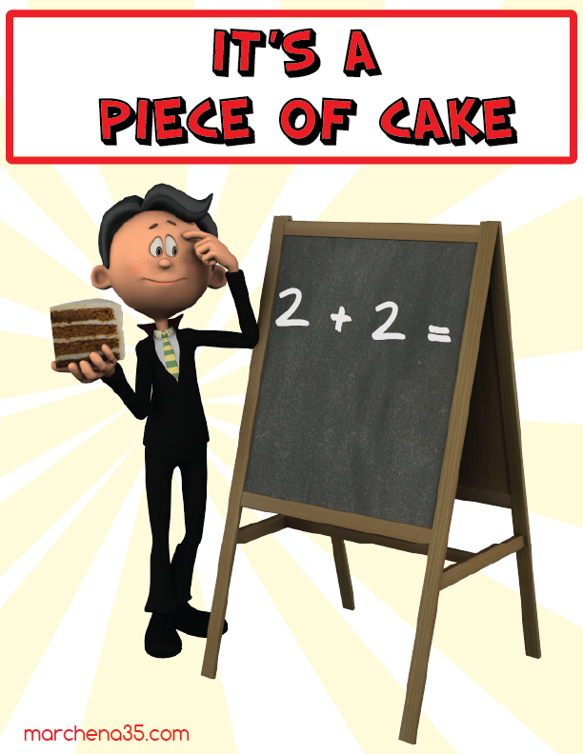
- something that is very easy to do

Slide 6
- something that will never happen,
- impossible

